Slide 1
A Community-Driven Vision for Sackville
Presentation to the District Education Council, Tuesday, November 27, 2018
Notes:
Photo: Fraser Mustard Early Learning Academy, Toronto, ON – Kohn Shnier Architects
Thank you - we’re really excited to share what we’ve been working on and thinking about for the past three years and to hear from you on your ideas. Our whole way of thinking is based on a community-driven vision, so we want to hear as much community input as possible!

Slide 2
What is at the heart of why we’re here?
Infrastructure Review Process:
Decision on closing Marshview Middle School
Recommendation on possible future infrastructure scenarios

Slide 3
Questions That Sparked The
Sackville Schools 2020 Movement
What is the best solution for our aging Sackville Schools?
How can we support our children and educators by including 21st Century learning in the plan?
What partnerships could we form that would benefit the entire community, present & future, and help see a plan in place by 2020?
Notes:
How SS2020 got started was a bunch of folks in Sackville recognizing something was likely to happen, considering the states of our schools, especially Marshview but really all three, and wanting our community to get to have a real say in what happens. Anyone is welcome to join in this work, or attend a meeting, or provide input whenever and however they can. The more minds on this the better! We also saw tremendous opportunity for Sackville as a whole if we could look at an integrated learning community model that has modern, shared facilities that could benefit everyone and enrich lifelong learning and community activity in Sackville.

Slide 4
Education is the backbone of Sackville
Education is the largest economic & social engine in Sackville
700 jobs with millions of $ in salaries & investments
A fully integrated education model would:
attract new families to Sackville
boost the economy
improve our rural community and Tantramar family of schools
better prepare our children for the future
Notes:
We are already an education town. And we have amazing assets to draw from - in our environment, our organizations and businesses, and in our people. An innovative approach to education that benefits all of us would attract new families to Sackville (in fact, even the vision of it already is doing this), it would boost our economy and perhaps most importantly, really help set our children up better for success in today’s and future markets.

Slide 5
Who is Sackville Schools 2020 (SS2020)?
WE ARE students, parents, educators, business owners, PSSC/Home and School members, and citizens who wish to engage the entire community about the future of education in Sackville. We are active volunteers that support education in our schools and have formed many partnerships over the past 3+ years.
WE AIM TO BE PROACTIVE, knowing that Marshview will close, we want to ensure that Sackville’s education model is designed by the community, for the community.
OUR GOAL is to advocate for modern facilities that benefit our children and all residents of Sackville and the Tantramar Region, present and future.

Slide 6
Since 2015, SS2020 has been forming partnerships and meeting with the community, collaborators & leaders:
Teachers, principals, coaches
PSSC, Home & School committees
>150 student interviews
Community Collaboration Cafés
10-Year Education Plan Workshop
Fielding Nair Architects, Jim Scott Architects, w/design sessions
C21 & Harvard Re-Design Lab
Educational design specialists, business leaders & developers
Minister of Education and EECD
MLAs Bernard Leblanc & Megan Mitton
MP Hon. Dominic LeBlanc
Sackville Mayor & Council
NB Business Council
Mount Allison University
NB Experiential Learning Task Force
There’s lots of SUPPORT & ENTHUSIASM for the SS2020 vision!

Slide 7
Ernst & Young Multi-Year Infrastructure Study (September 2017) All options provided are based on Marshview Middle School closing Sackville Schools 2020 has supported the urgent need to close Marshview Middle School since our original correspondence to the DEC in 2015.

Slide 8
>> Concluded that 2 Sackville schools (Marshview & Salem) are in “poor” condition, while Tantramar is rated as “Fair” condition (according to the Facility Index Condition applied to each building)
E&Y Infrastructure Study

Slide 9
Overall average FCI* is rated POOR for the four schools included in the review
E&Y Infrastructure Study

Slide 10
E&Y Infrastructure Study
>> confirms SS2020’s view that Marshview is beyond its life expectancy and, given the demographic analysis, current space configuration and design of these schools, all 3 Sackville schools should be replaced.
Notes:
Spare slide - in case we want to use a submit comments in real time format

Slide 11
SS2020 Recommendation to the DEC
Closure of Marshview Middle School
Plus consider the overall E&Y Report and consider Salem Elementary and Tantramar Regional for closure.
We propose a new approach to building schools, where the community at the table.
Consider the development of an integrated learning campus where all students can benefit from new, state-of-the-art learning spaces that are part of a shared community set of facilities.
Notes:
Why is now the right time? Many reasons. We have a lot of aging infrastructure here in Sackville. Things are going to change, one way or another. We have the support, and the partnerships in place, to allow that change to happen in a holistic, integrated way that could really put Sackville on the map as a best-in-class example of a thriving learning community.

Slide 12
SS2020 Recommendation to the DEC (con’t)
Collaboration between Town, schools, university, province, & the private sector can achieve much more than any one on their own.
Attract multiple sources of funding (including federal)
Shared resources and amenities
Shared services, shared expertise, bringing together university & community
Include granting agency & revenue-generating opportunities
Notes:
Why is now the right time? Many reasons. We have a lot of aging infrastructure here in Sackville. Things are going to change, one way or another. We have the support, and the partnerships in place, to allow that change to happen in a holistic, integrated way that could really put Sackville on the map as a best-in-class example of a thriving learning community.

Slide 13
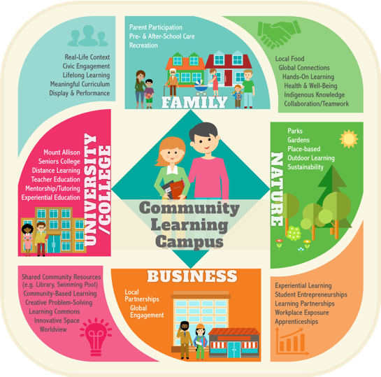
IMAGINE an education model that pulls together everything that makes our community great. Sharing resources saves money and allows for lots of collaboration!
Notes:
So what could this integrated, community-based model look like? It’d be a holistic approach considering the needs for 21st century learning, but also the lifelong learning and asset needs of the community. Imagine an integrated approach to education and new facilities that allows for things like healthy and environmentally sustainable spaces for our kids, but also the seniors college, maybe distance learning with the community college if we have state-of-the-art trades facilities, smart use of our nature and environmental assets for outdoor learning, community living and shared resources that could include daycare, preschool, a cafe, a theatre, new town library space, meeting and business spaces. A model that allowed for more integration and enriched lifelong living from preschool to seniors. Imagine the possibilities!

Slide 14
An idea for Option 4
Option 4: A Community-Based Partnership for the development of an integrated learning campus in Sackville.
A campus of new facilities that is cost-shared, builds on our current assets, and is designed with significant community input on:
location,
grade configuration, and
additional amenities.
Notes:
So here is what we’re thinking: (READ SLIDE). This isn’t pie-in-the-sky stuff. Community-driven models exist, and are huge successes - including here in New Brunswick, with Carrefour Beausoleil in Miramichi and Sainte-Anne in Fredericton, which are community learning and recreation centres that lease space to the Dept. of Education for the schools located there. What we propose is an integrated model that provides modern facilities for all grades that also provides shared and additional services for the town.
Both Carrefour and Sainte-Anne in Fredericton are community learning and recreation centres with a community centre board that leases space to the dept. of education for the schools located there.
Here is the description of Carrefour:
École Carrefour Beausoleil is part of a school and community complex located near the English-language high school, Miramichi Valley High School (MVHS). The Beausoleil Crossroads Center is a multifunctional 92,000 square foot facility serving both the Francophone community of the greater Miramichi region and a school population of approximately 235 young Francophones and Francophiles. The Center includes the school sector with the premises or classes for students from kindergarten to 12 ^{th}year, premises for boards of elementary and high school students, administrative area, teachers' lounge, science laboratory, two computer labs, class of recovery, class for distance courses, music class with studios, class d 'art and an office center and meeting room for student services.
In partnership with the Community Center, the school shares a double gymnasium, two rooms for racquetball, the cafeteria, a technologically well-equipped amphitheater, a media library and meeting rooms. The Center also houses a daycare center, a nursery school, an Access Center, offices for public health services and a small chapel. Outdoor playgrounds for primary and preschool, outdoor ice rink, soccer field and tennis court complete our outdoor facilities.

Slide 15
The SS2020 Proposal
We envision a COMMUNITY LEARNING CAMPUS with modern facilities to suit the needs of Sackville. This could include:
Distinct learning communities with shared facilities
Expanded trades & internships
Community facilities & meeting spaces
Shared services (e.g. public health, town library)
Athletic facilities
Seniors college
Community-driven models exist
with great success
elsewhere in NB!
Notes:
This isn’t pie-in-the-sky stuff. Community-driven models exist, and are huge successes - including here in New Brunswick, with Carrefour Beausoleil in Miramichi and Sainte-Anne in Fredericton, which are community learning and recreation centres that lease space to the Dept. of Education for the schools located there. What we propose is an integrated model that provides modern facilities for all grades that also provides shared and additional services for the town.
Both Carrefour and Sainte-Anne in Fredericton are community learning and recreation centres with a community centre board that leases space to the dept. of education for the schools located there.
Here is the description of Carrefour:
École Carrefour Beausoleil is part of a school and community complex located near the English-language high school, Miramichi Valley High School (MVHS). The Beausoleil Crossroads Center is a multifunctional 92,000 square foot facility serving both the Francophone community of the greater Miramichi region and a school population of approximately 235 young Francophones and Francophiles. The Center includes the school sector with the premises or classes for students from kindergarten to 12 ^{th}year, premises for boards of elementary and high school students, administrative area, teachers' lounge, science laboratory, two computer labs, class of recovery, class for distance courses, music class with studios, class d 'art and an office center and meeting room for student services.
In partnership with the Community Center, the school shares a double gymnasium, two rooms for racquetball, the cafeteria, a technologically well-equipped amphitheater, a media library and meeting rooms. The Center also houses a daycare center, a nursery school, an Access Center, offices for public health services and a small chapel. Outdoor playgrounds for primary and preschool, outdoor ice rink, soccer field and tennis court complete our outdoor facilities.

Slide 16
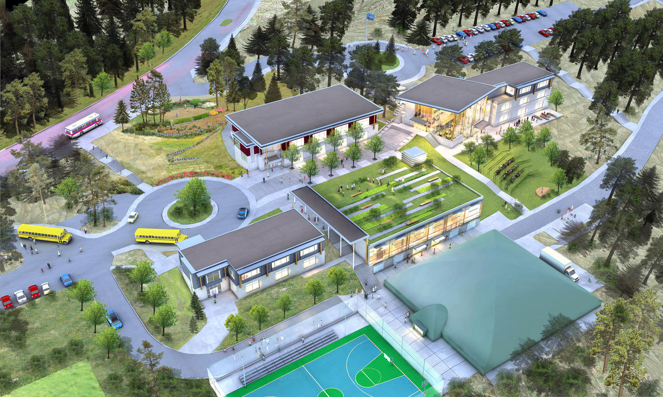
Imagine a Community Learning Campus in Sackville Inspired by examples like this K-12 school campus in Kelowna, BC
Notes:
A K-12 school from Kelowna, BC

Slide 17
Recommendations Beyond Policy #409
Compared with the typical process, the SS2020 idea could:
be highly innovative & more cost effective
be revenue-generating and open for community use
use the Education specifications as a guideline, NOT the rule
involve DEC & community in key decisions not currently offered
allow the DEC to meet their mandate of “creating community partnerships”
support new & existing assets (e.g. Tantramar Wetlands Centre)
offer community spaces & services, meeting a wide range of community needs (e.g. Education, Recreation, Youth, Health Care, Seniors and Early Childhood Education, etc.)

Slide 18
Community partnerships already exist in NB:
Riverview Arts Centre & Royal Theatre at Riverview High
Pat Crossman Memorial Aquatic Centre/Town of Riverview
Port Elgin Health Clinic at Port Elgin Regional School
Port Elgin Community Library soon to be located in the school
Carrefour Beausoleil in Miramichi and Sainte-Anne Community Centre in Fredericton
…why not a partnership in Sackville?
Notes:
Make the point that anything in this direction - with community significant involvement - can only happen within Option 4.

Slide 19
Telling a new story about education in NB
An Integrated Learning Community can be a reality in Sackville if we continue to work with key partners:
EECD Assistant Deputy Minister of Education, Chris Treadwell & MLA Megan Mitton
Strong supporters of the Sackville Schools 2020 vision!
MP Dominic LeBlanc, ACOA and Intergovernmental Affairs
Federal funding earmarked for this project and on-going consultations
Town of Sackville Mayor and Council & Mount Allison University
SS2020 is included in the Town’s Strategic Plan
Mount Allison President as Advisor; Vice-President appointed to SS2020
Many existing partnerships in our schools
Ashford Development Group as a partner with our Non-Profit Group
Proposal ready for an integrated education facility in Sackville!
Notes:
This is a real opportunity. The vision is shared and supported across all levels of government, as well as municipal and private sectors. We’re so happy Chris Treadwell is here tonight; he has been an amazing resource to us. We have been told there is federal funding earmarked for this project. The vision is included in the Town’s Strategic Plan, recognizing the potential economic and social development benefits of this new integrated educational model. Ashford Development Group - who has extensive experience building schools - has a proposal ready for an integrated education centre in Sackville. (We’re glad Jim could be with us here tonight as well and can speak to that further if you have questions.) This can happen!

Slide 20
November 20 Speech from the Throne…
…Collective action and community action are not always expressed through government programs. They can be inspired by government, but they are always driven by determined citizens.
…In the next six months, the Minister of Education and Early Childhood Development will organize an education summit. This summit will seek to find partners for initiatives such as community schools, after-school learning models, cooperative and volunteer education, and experiential learning.
Notes:
And it could happen in a reasonable timeframe, which I know is important to the parents out there concerned about the quality of the buildings our kids are in. In fact, even with an extensive community design consultation process we would build in, we could see breaking ground in 2020!

Slide 21
Moving forward…An exciting timeline:
November 2018 – January 2019
Seek a lease agreement with AESD, the Town of Sackville, Ashford Developments, Federal Government and others
January 2019 – June 2019
Extensive community design consultation process
July 2019 – March 2020
Developer, architectural & facility design
April 2020
Break ground for the new Community Learning Campus!
Notes:
And it could happen in a reasonable timeframe, which I know is important to the parents out there concerned about the quality of the buildings our kids are in. In fact, even with an extensive community design consultation process we would build in, we could see breaking ground in 2020!

Slide 22
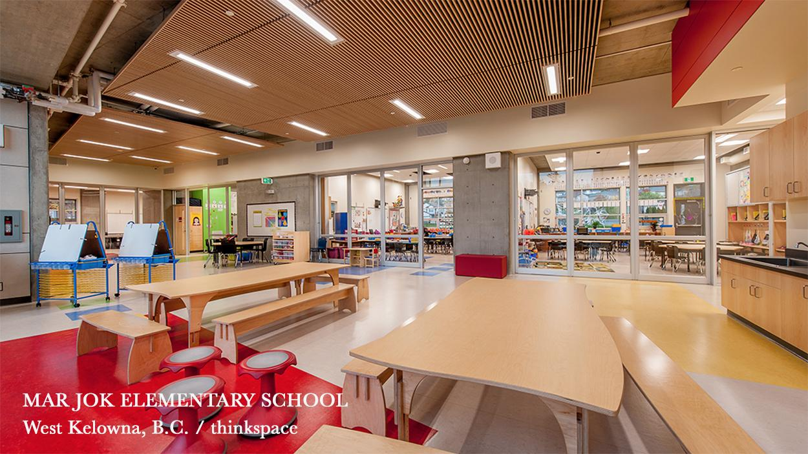
IMAGINE flexible spaces for learning & collaboration.

Slide 23
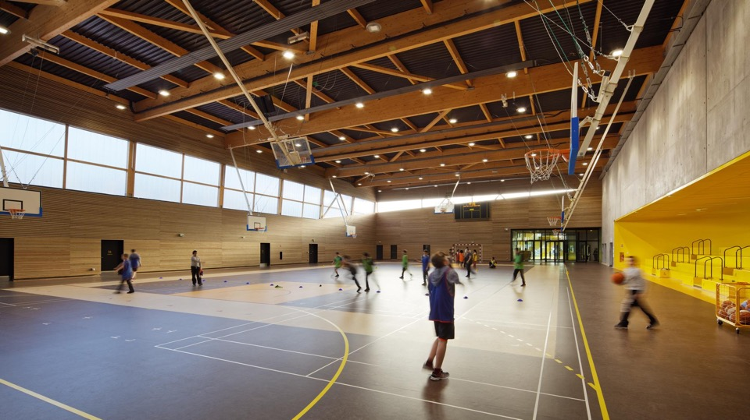
IMAGINE .
IMAGINE mindfully-designed facilities that
support health & well-being.

Slide 24
Together, we can
make this vision
a reality & help
Sackville thrive!
Notes:
Together, we can make this vision a reality and help Sackville thrive. We also know that together, this vision can continue to improve and get even stronger, so we look forward to hearing all your ideas and input. Thank you!

